Slide 1
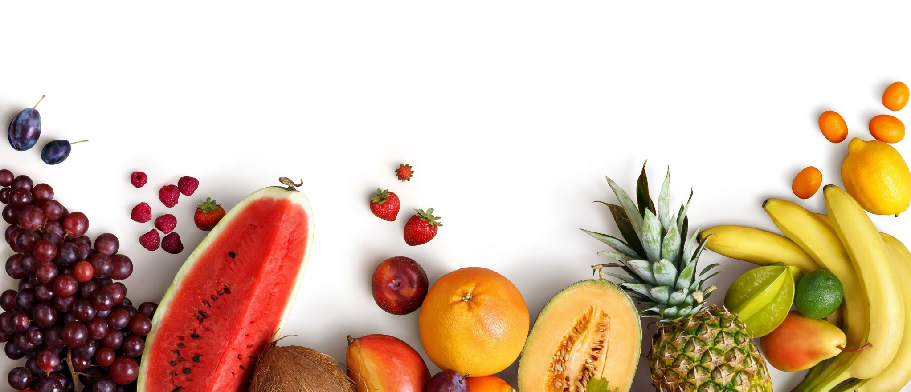
Automated Freshness And Defection Detector

Slide 2

Group Foxtrot-A
Name | ID
Sumaiya Kashmin Zim | 201814016
Zannatul Ferdous | 201814024
Eusha Khan | 201814032
Fardeen Ashraf | 201814046
Md. Shahir Zaoad | 201814058

Slide 3
Project analysis slide 2
Presentation Outline
Introduction
Objectives and features
Contribution of the system
Project Scheduling
Diagrams
Requirements
Software testing
Experimental study
Limitations

Slide 4
Introduction
One of the biggest problems in the food industry is that it faces food spoilage and these spoilt items are going undetected and onto the hands of the consumer.
The process of checking of quality of items is done manually depending on human eye which in most of the cases fails to give an accurate result.
This automated defect detection project intends to create an automated system to identify raw and stale elements and separate them from the fresh ones.

Slide 5
Objective
To create a detector of freshness and defection for grading general fruits (apples, bananas, oranges) for industrial use
To establish an efficient automated process to increase the accuracy of spoilt fruits detection
To reduce required manual manpower and human dependency at industrial level
To introduce image recognition system and computer vision to make the defect detection system viable, robust and fast

Slide 6
Features
Classification of 3 types of fruits (Apple, Banana, Orange)
Identification of freshness and hence determining whether fruits are stale
Automatic separation of fresh and defected fruits according to their fruit type
Keeping records of daily inspected fruits using database through local network
Permit owner access to the date-wise statistical data from the database using website.

Slide 7
Users of the System
Client of the project is Food industry
It has two ends of users
Owners
Workers

Slide 8
Contribution
We created a detector of freshness and defection for grading fruits to establish an efficient automated process with an increase the accuracy of spoilt fruits detection at industrial level.
We trained the model using Convolutional Neural Network (CNN) & classified the fruits into 6 categories.
-Fresh Apple, Fresh Banana, Fresh Orange,
Defected Apple, Defected Banana, Defected Orange
The accuracy we obtained from the trained model is 98.4%

Slide 9
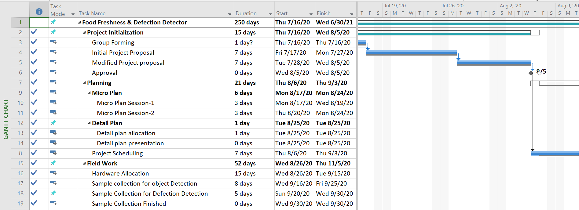
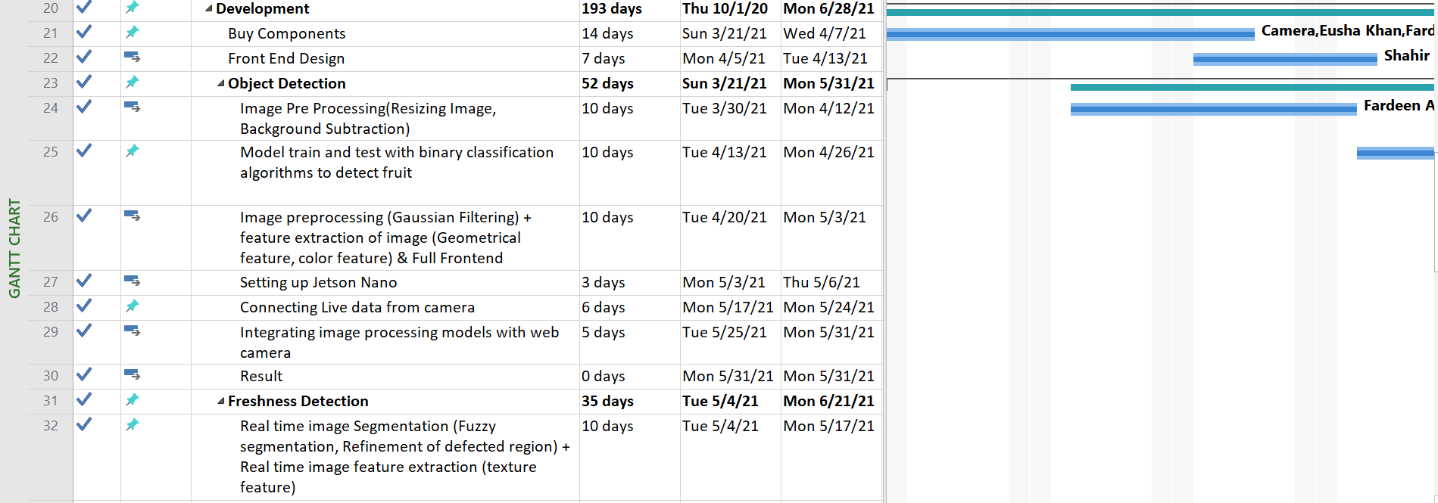
Project Scheduling

Slide 10
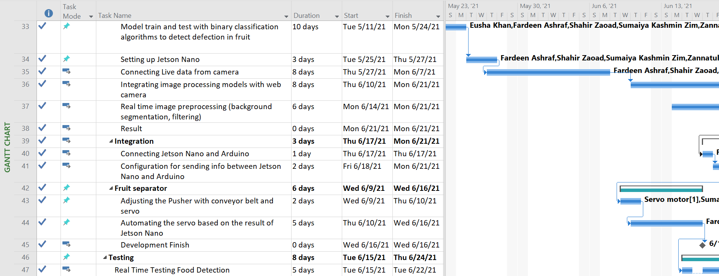
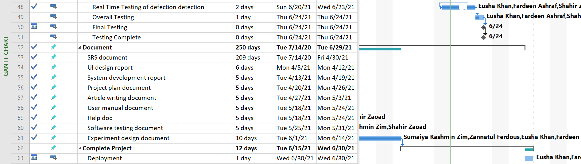
Project Scheduling

Slide 11
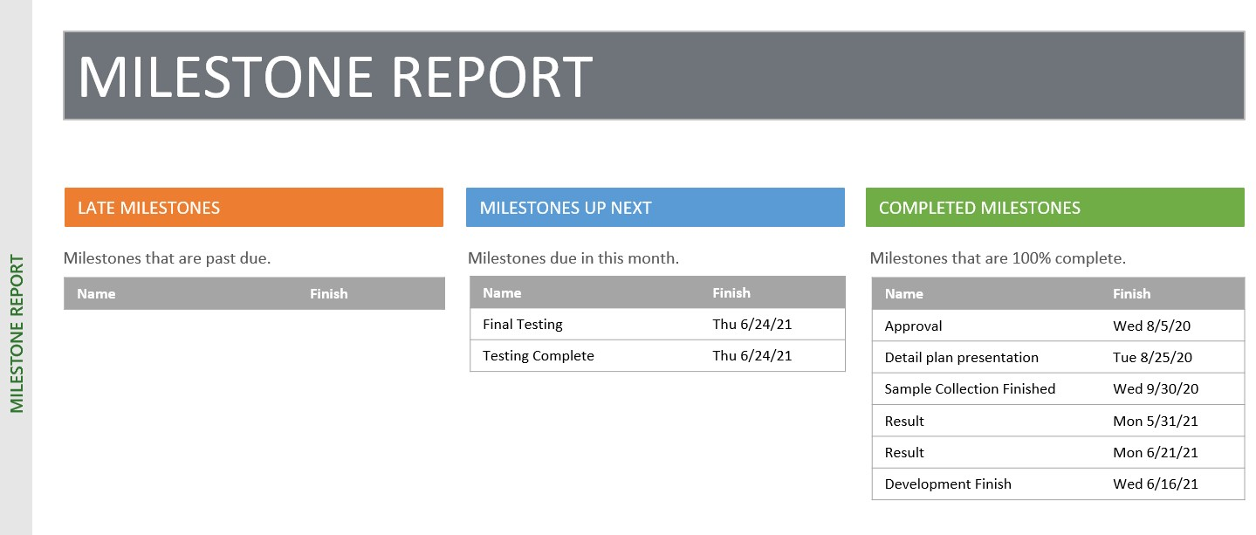
Project Scheduling

Slide 12
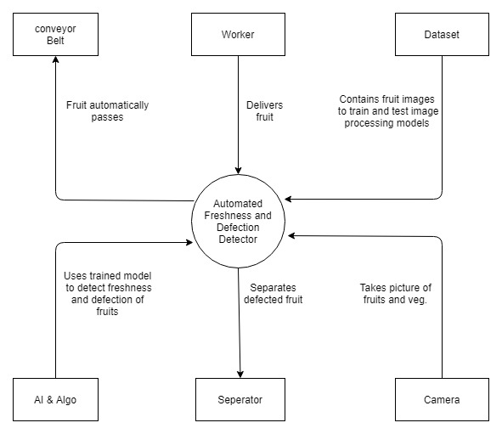
Context Diagram

Slide 13
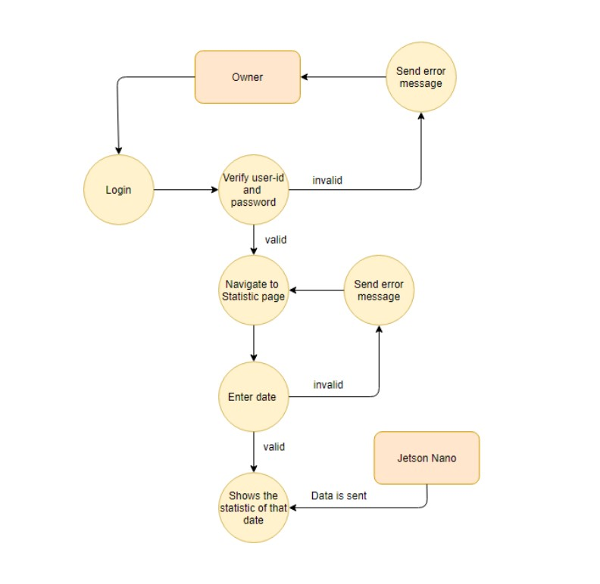
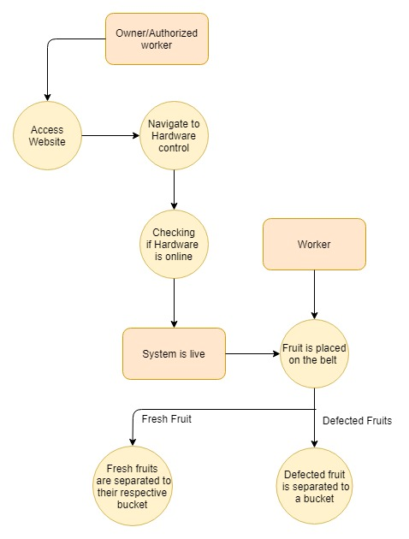
Data Flow Diagram
Scenario 1
Scenario 2

Slide 14
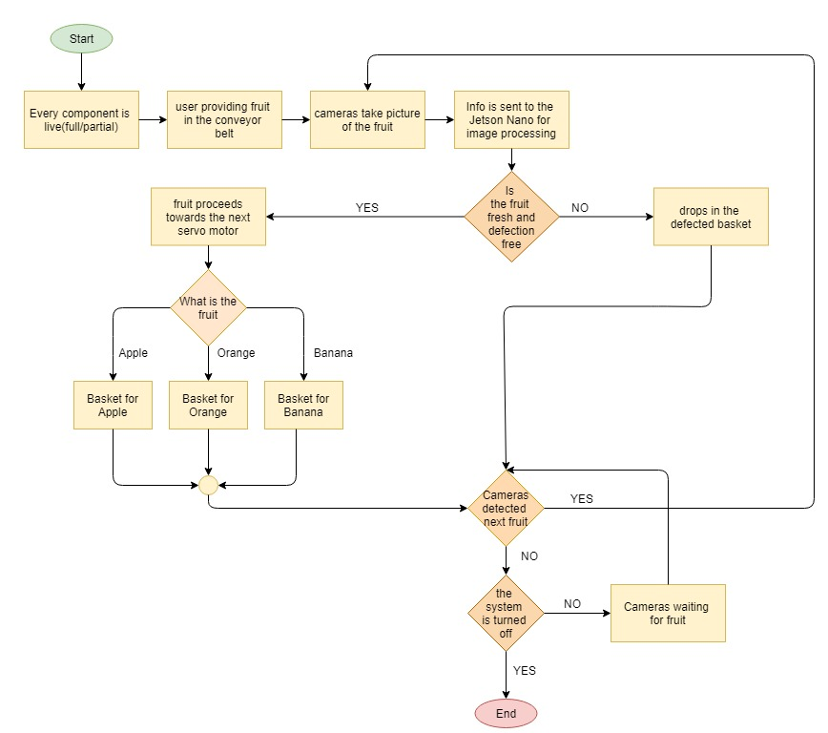
Workflow Diagram

Slide 15
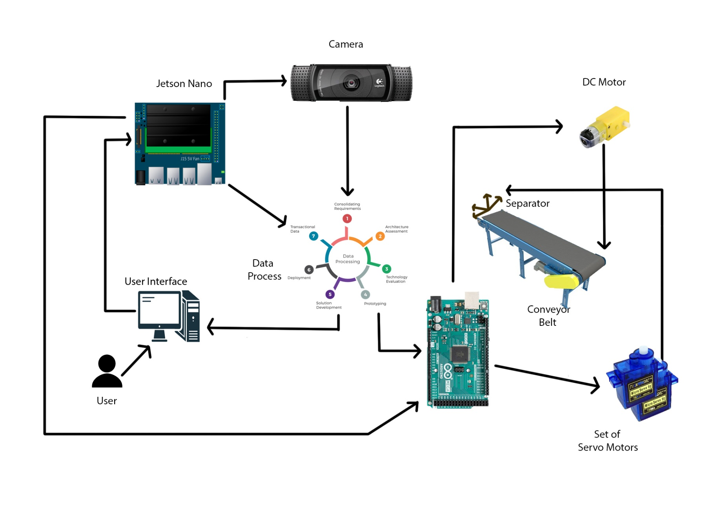
System Architecture

Slide 16
User Requirements
Functional Requirements
The system should be able to identify stale and defected fruits.
The system should be able to separate the defected fruits from the fresh ones
The system should have an enriched and versatile database of fruits.
Non-Functional Requirements
The system should need the least amount of human inspection during the automated process.
The system should be user-friendly.

Slide 17
Software Testing
We used Katalon software for testing different functionalities of the system.
Authentication, processing and interaction were tested in a total of 3 test suites.
We performed 6 different test cases
The outcome ensures that minimal faults/crashes occur during the usage of the system by the respected users.

Slide 18
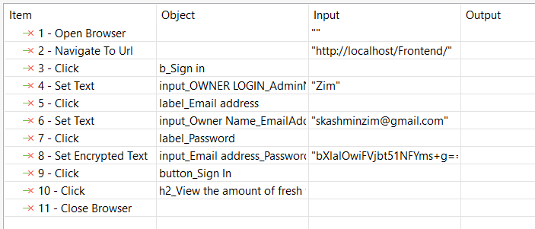
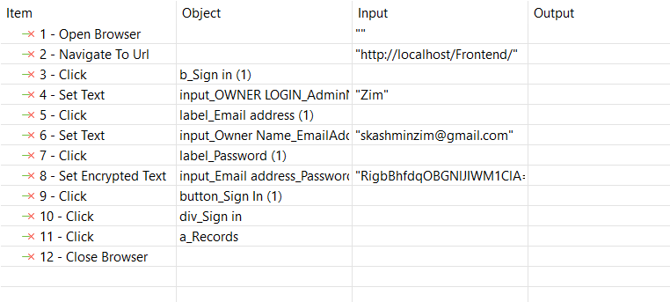
Software Testing
Authentication
False Authentication

Slide 19
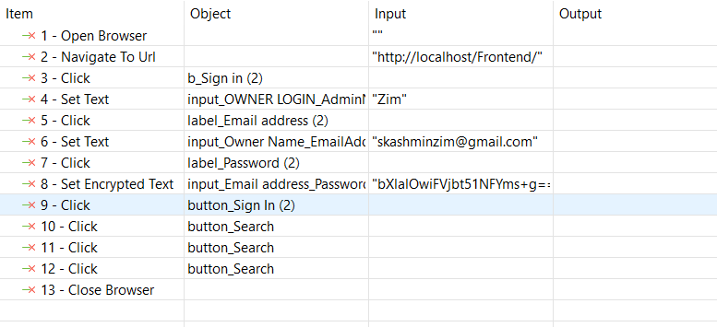
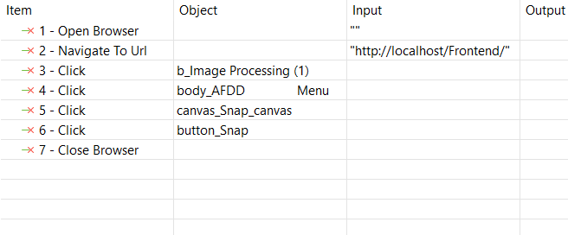
Software Testing
Image Processing
Records Retrieval

Slide 20
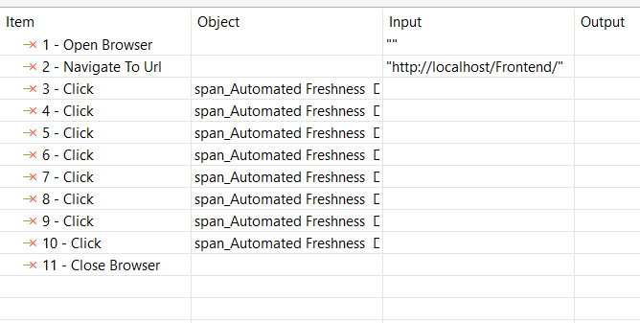
Software Testing
Component Button Testing
Navbar Routing

Slide 21
Experimental Study
An evaluation study was conducted by using the agile process to measure the functionality and usability of the proposed system.
For each primary functionalities of the system, a test case scenario was prepared and then conducted five times.
The evaluation tasks were done by five people.
The participants are somehow related to business or industrial field.

Slide 22
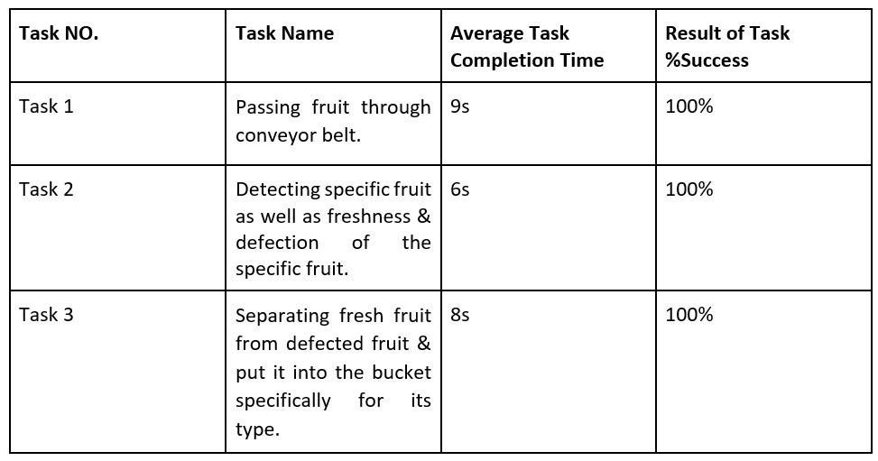
Experimental Study – Functional Accuracy

Slide 23
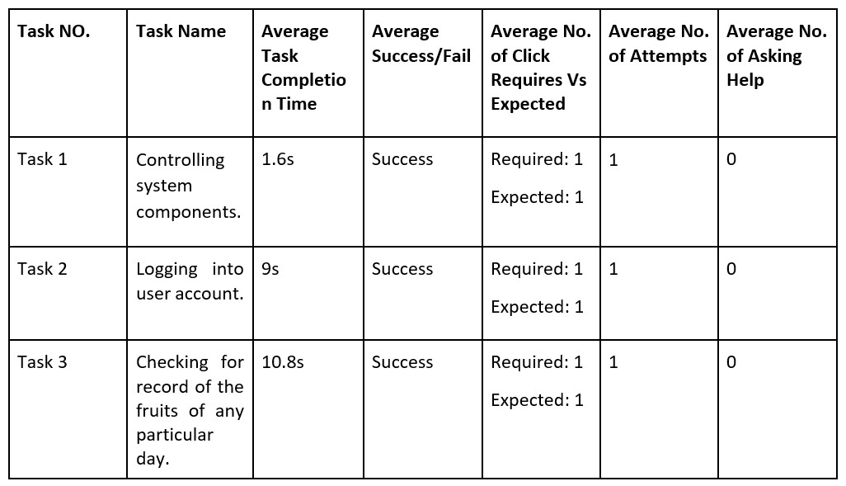
Experimental Study - Data Analysis

Slide 24
Limitations
It can detect and separate only three types of fruits.
Detection speed needs to be improved.
Conveyor belt speed needs to be improved.

Slide 25
Future Work
New features such as auto-packaging of fresh fruits can be developed
Same method can be applied to a wider range of fruits
The system can be implemented for other food products such as vegetables and stored foods (e.g. canned food)
Improved image processing and machine learning methods can be implemented to grade food items according to their freshness

Slide 26
Thank you

